Slide 1
Wilderness Resource Advisor
READ/REAF
Ralph Swain
Rocky Mountain Region Wilderness Program Manager
R2 Wild & Scenic Rivers Coordinator
ralph.swain@usda.gov
303-275-5058

Slide 2
Quals, Getting Ordered Up and R2 WRA List
Agency Administrator, Agency Rep and READ
Adapt to change, be flexible and resourceful
Ferguson Fire 2018 – Yosemite NP (example)
Wild and Scenic Rivers – and READ Assignments

Slide 3
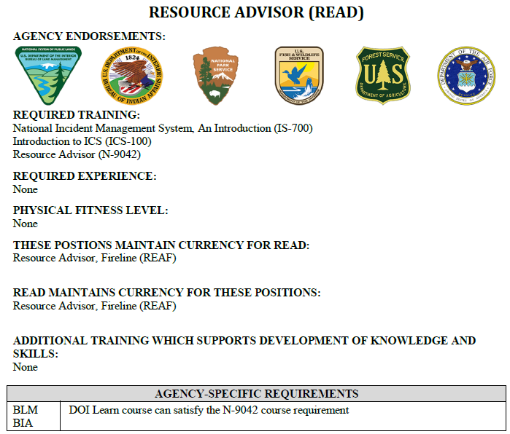
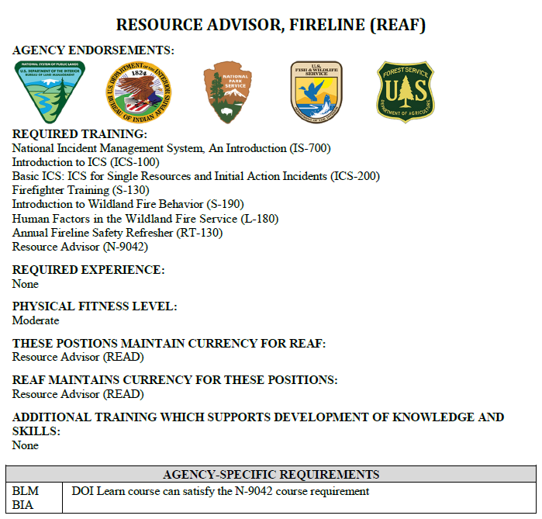
READ/REAF Qualifications Ready, Set, GO
What's the Difference between a Resource Advisor (READ) and a Fireline Resource Advisor (REAF)

Slide 4
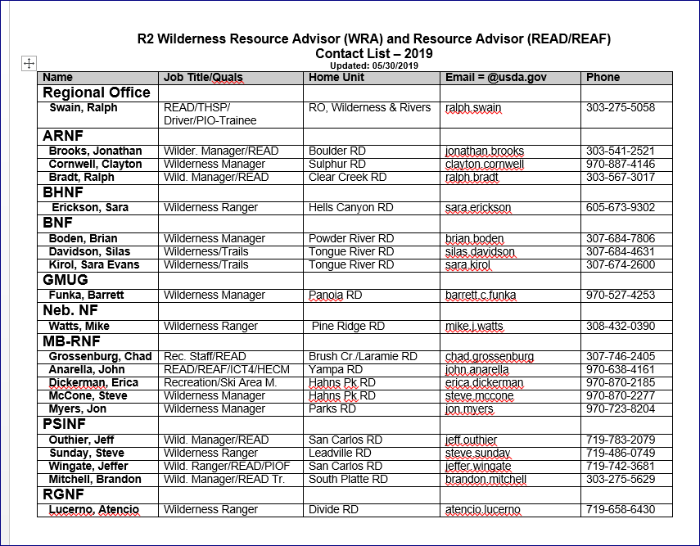

Slide 5
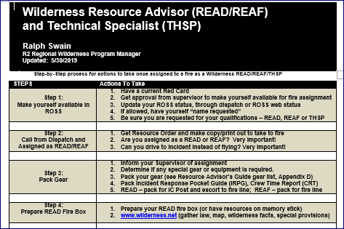

Slide 6
Chain of Command and READ/REAF Communications
Agency Administrator
Agency Representative
Incident Commander
Operations
Planning
Logistics
Finance
DIVS
READ
READ/REAF
Supervision
Communication

Slide 7
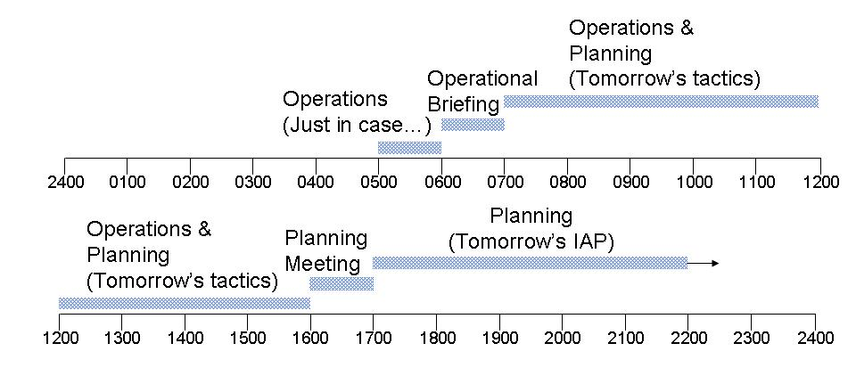
Planning/Meetings Cycle Lead READ
Lead READ
Meetings/Briefing/Planning

Slide 8
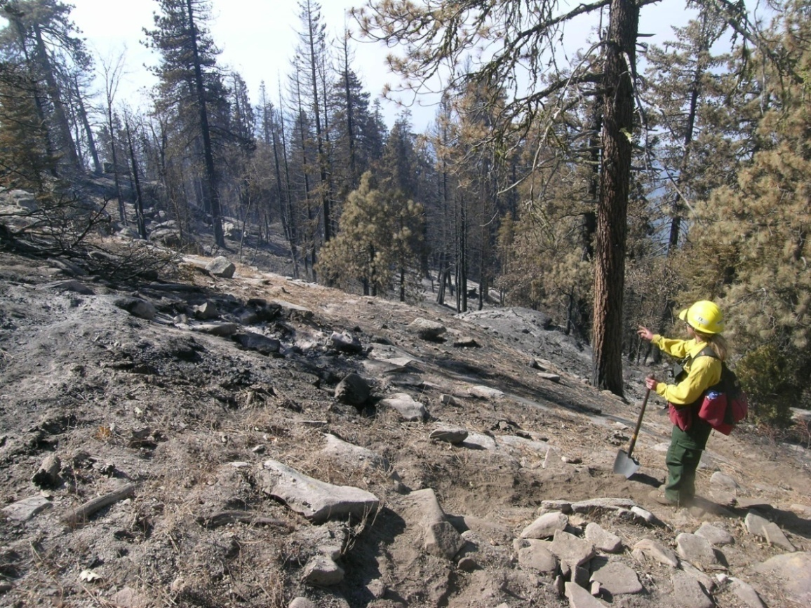
Read/REAF Fireline Responsibilities
Fireline READ (REAF)
Listed on the IAP
Attend DIV Briefing Breakout
Assigned to Divisions
Report to a Division Supervisor (DIVS)
Need-based…put subject-matter experts
in appropriate places/divisions
Pair-up for safety, increased effectiveness

Slide 9
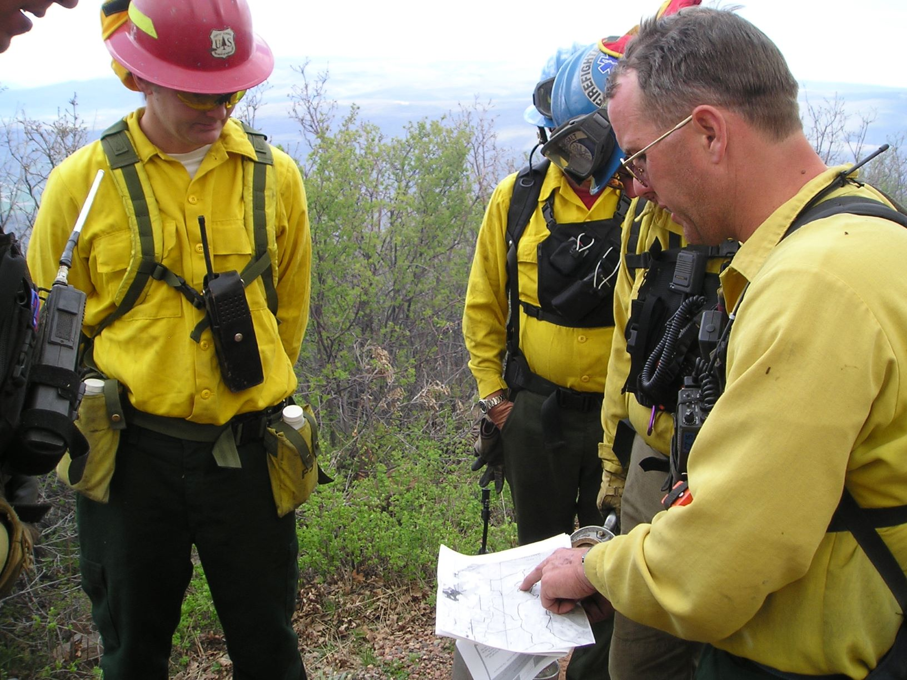
REAF working with Division
A Brief Overview

Slide 10
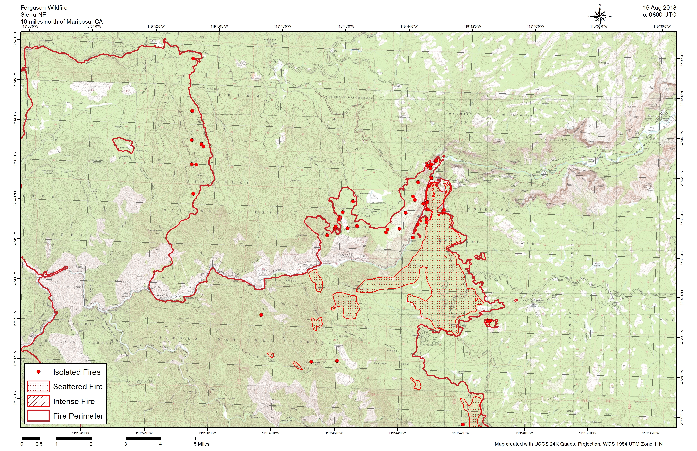
Ferguson Fire, Yosemite 7/18/2018

Slide 11
SUPPRESSION REPAIR Excavators w/thumb
Good for rehabbing dozer line & other large areas
Drainage improvements
Hazard trees

Slide 12
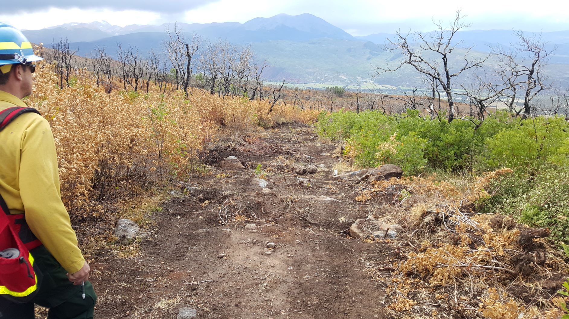
Collector in Action
Info transfer from field to Web, stays with Incident

Slide 13
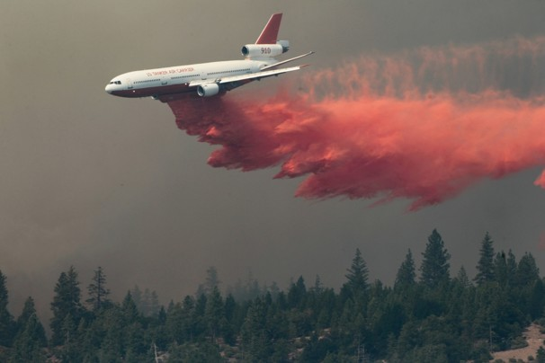
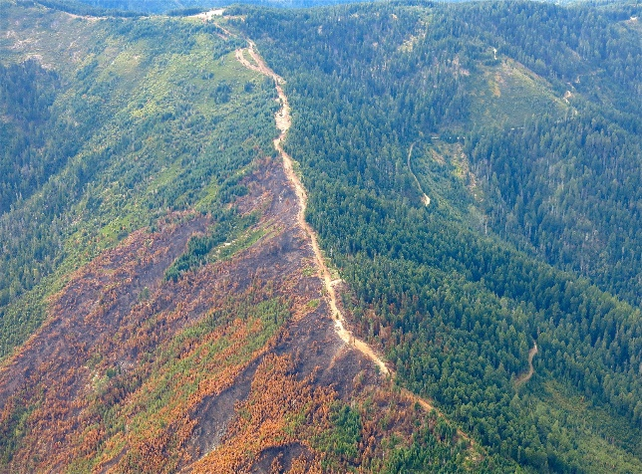
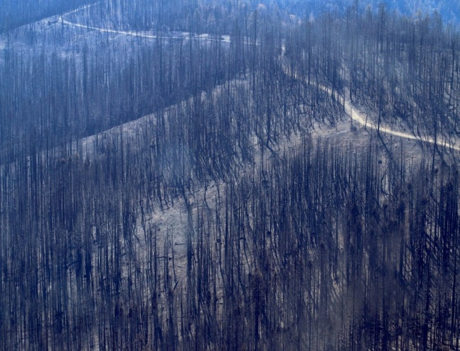
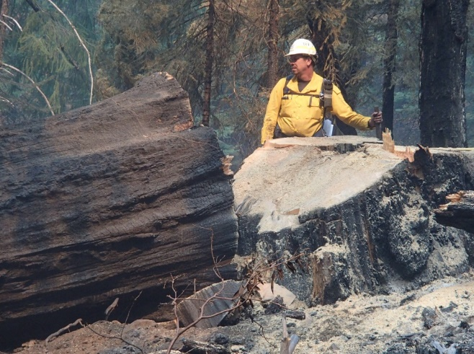
Retardant
Dozer Line
WILDERNESS READ – ANTICIPATE AND PREPARE
Burn Severity-Watershed Effects
Hazard Tree Mitigation

Slide 14
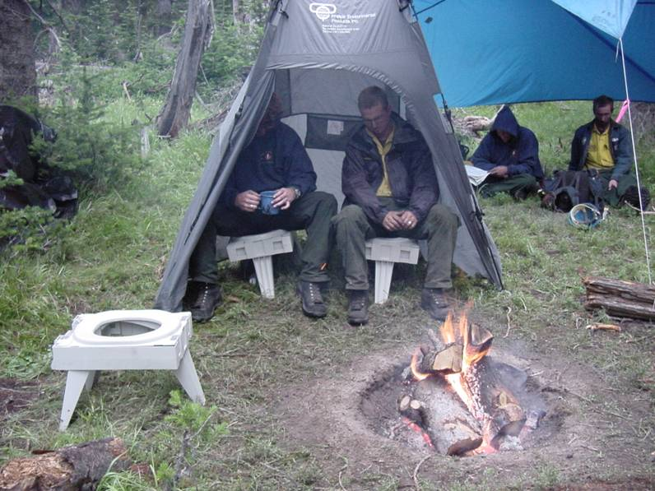
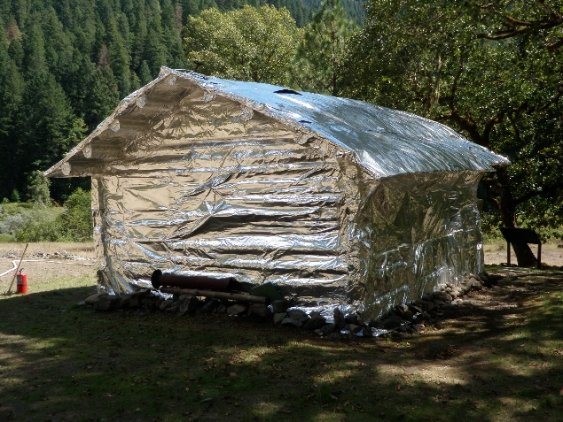
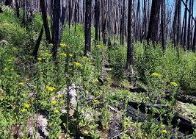
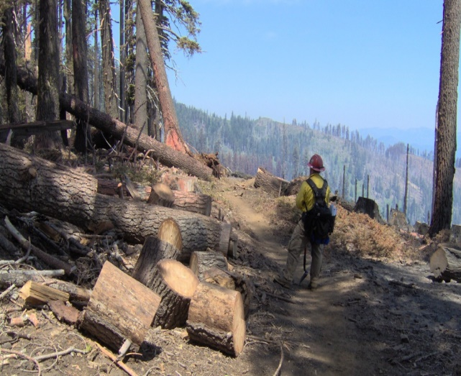
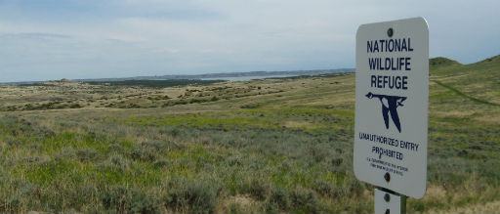
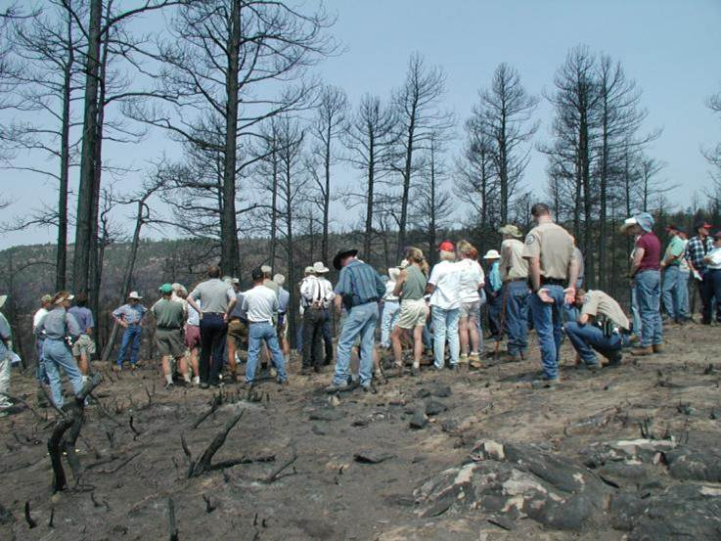
Camp management
Historic Structures
Weed Management
ANTICIPATE - Fire Management Considerations
Suppression Repair or BAER
Adjacent Landowners and Partners
Community Affairs

Slide 15
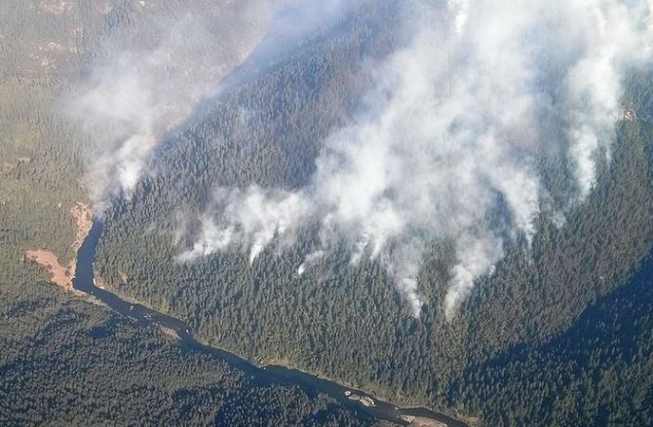
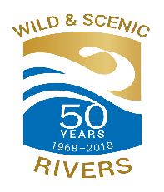
Fire Management and Wild and Scenic Rivers
50TH Anniversary – 1968 - 2018

Slide 16
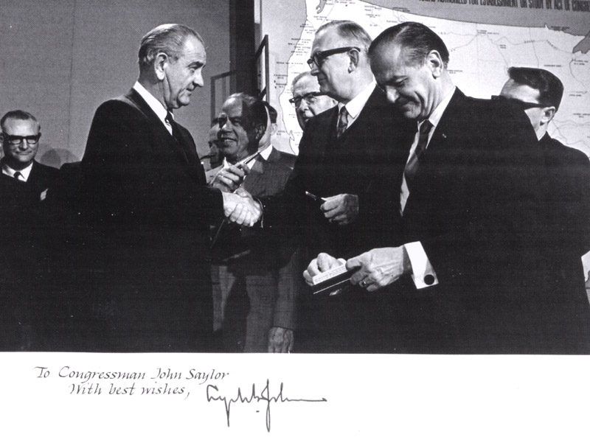
Wild & Scenic Rivers History
Wild and
Scenic Rivers Act
Oct. 2, 1968
“...we are establishing a National Wild and Scenic Rivers System which will complement our river development with a policy to preserve sections of selected rivers in their free-flowing conditions and to protect their water quality and other vital conservation values.”

Slide 17
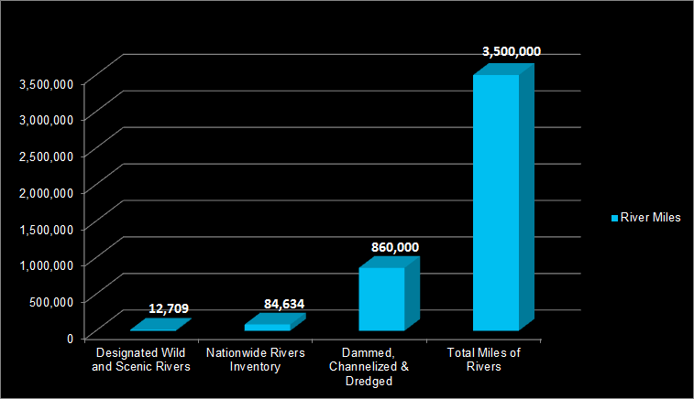
The National System of Rivers
What has
the Wild & Scenic Rivers Act accomplished nationwide?
226 rivers in 41 States
A little over ¼ of 1% the nation’s rivers
13,413

Slide 18
WSRA Section 10(b)
Relationship of Wilderness Act to WSR Act
2 (a)(c) ‘Unimpaired’ and ‘substantially unnoticeable’
4(b) Wilderness character
4(c) Motorized prohibitions and authorizations
4(c) Minimum necessary requirements
Rivers – protect free flow, water quality and ORVs
Apply both laws. If there is a conflict, the more restrictive provisions apply.
Special legislative provisions

Slide 19
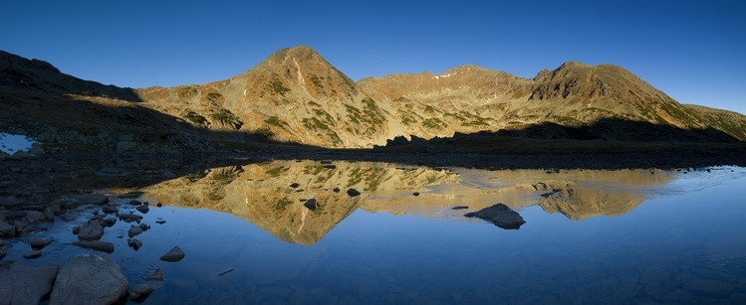
Questions?

